Slide 1


Software Engineering Project Presentation
A Dental Clinic Management System
Group Members:
Ania Keçi
Belita Hysaj
Idi Xhengo
Klea Lala
Renis Garxenaj

Slide 2
Table of Contents
External Interface Requirements
Nonfuctional and Other Requirements
Introduction
Software Testing
Overall Description
System Features and Functional Requirements
Software Design and Modeling

Slide 3
Introduction
Many dental clinics in our country nowadays continue to rely on manual record-keeping methods, which can be time-consuming, error-prone, and limit effective workflow management.
Acknowledging this difficulty from many first-hand experiences, a web application has been developed with the intention of transforming dental clinic administration systems.

Slide 4

Introduction | Purpose
MANUAL RECORD-KEEPING
X-RAY MANAGEMENT
STUDENTS
Future Prospects
This online application intends to streamline operations, increase efficiency, and improve overall patient care by digitizing critical procedures.
Despite technological developments, a large proportion of dental clinics still use manual record-keeping methods, making obtaining and updating patient information challenging.
Dental clinics may now securely store and view X-ray pictures within the program with this digital solution.
The web application features a module that caters to the demands of dental students throughout the course of their dentistry practice.
The web application's benefits include improving overall productivity, lowering expenses associated with manual record-keeping, and increase patient satisfaction. Furthermore, the application sets the groundwork for future developments.

Slide 5
Introduction | Product Scope
Purpose and Benefits
These features decrease administrative hassles, eliminate mistakes, and increase workflow efficiency, allowing administrators and employees to devote more time to patient care.
The fundamental goal of the management system is to simplify and optimize many elements of dental clinic operations, eventually improving patient care quality and clinic efficiency through more effective user data administration.

Slide 6
Introduction | Product Scope
Alignment with Corporate Goals
Improved Efficiency
By automating manual operations and streamlining data administration, the program improves overall clinic efficiency, freeing up staff members to focus on providing better patient care.
Improved Patient Experience
By providing quick appointment booking, easy access to medical records, and safe storage of X-ray pictures, the online application improves the patient experience.
Cost Savings
By minimizing paperwork, removing the need for physical X-ray storage, and improving resource allocation, the program assists clinics in saving money on manual record-keeping.
Technological Innovation
The online application's implementation demonstrates the clinic's dedication to adopting technology improvements in the area of dentistry.

Slide 7
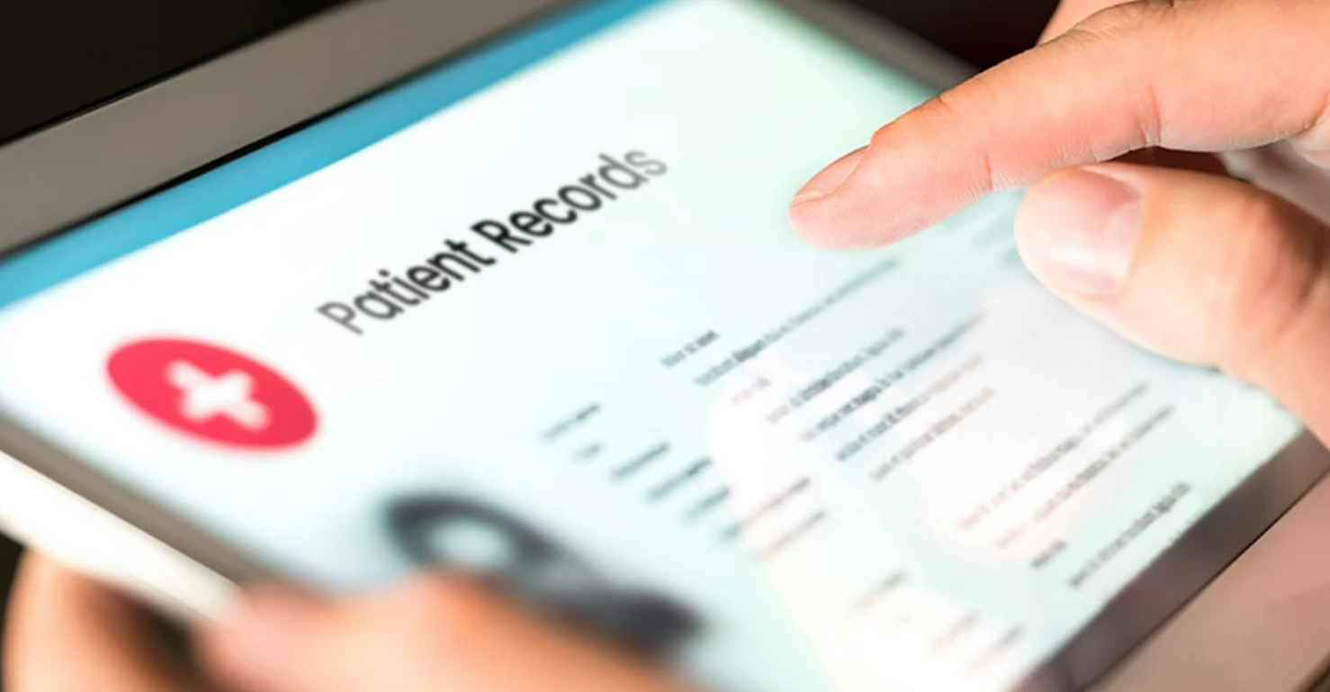
Overall Description | Product Perspective
This dental clinic management system web application was created by our team of five members and it is a new, independent product created in order to try to meet dental clinics' demands and improve their day-to-day operations.
This online application acts as a digital platform that streamlines numerous clinic management duties. It does this by using technologies like PHP, MySQL, HTML, CSS, and JavaScript.
What inspired this application was the mere observation that many dental clinics still manually enter data, relying on antiquated procedures and paper-based systems.

Slide 8
Overall Description | Product Functions
Administrators possess most of the functionalities that the system provides. They can create, read, update and delete all the entities of the system such as staff members, patients, appointments, services and more.
Each staff member can perform the CRUD operations on the students, patients, emergency contacts, appointments, X-Rays, services and notes.
Due to their specific educational needs and also to guarantee data safety, dental students only have a few limited functions. For instructional purposes, they can view patients, emergency contacts, X-Rays, appointments and notes.
Patients can read details about the clinic's services, including their durations, fees, and descriptions, in order to be more informed. They can book appointments to their preferred schedules of days and hours, they can add X-Rays.

Slide 9





Overall Description | Operating Environment
Hardware Platform
The application may run on ordinary hardware that is typically used in web-based systems. It works with desktop PCs, laptops, and mobile devices such as tablets and smartphones.
Operating System
The dental clinic management system web application is compatible with various operating systems such as Microsoft Windows, macOS, Linux etc.
Web Server and Software Components
The dental clinic administration system web application requires a web server that can run PHP scripts and provide HTML, CSS, and JavaScript files in order to function properly.
Web Browser
The application should be cross-platform compatible with the major web browsers, guaranteeing consistent functionality and user experience.

Slide 10
External Interface Requirements
User Interfaces
Multiple user interfaces are included in this web application for enabling interactions between the software and its various users. These user interfaces are intended to be intuitive and easy to use while assuring quick navigation.
Admin Interface: The main control point for overseeing the entire system is the admin interface.
Staff Interface: The dental clinic staff is taken care of via the staff interface which gives them the resources they need to manage staff-related duties.

Slide 11
External Interface Requirements
User Interfaces (Continued)
Student Interface: The main goal of the student interface is to provide to students all the services they need to access. They get restricted access to patient data and appointment calendars thanks to it.
Patient Interface: The goal for the patient interface was to make it as easy as possible for patient users to access the web application.
The web application is available to patients, who can use it to schedule appointments as well as view possible services that are offered by the clinic.

Slide 12
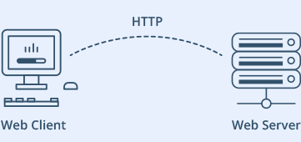

External Interface Requirements
Hardware Interfaces
User input and output are the main ways that physical components and software interact. When input is processed, the system displays the relevant output on monitors, screens, or mobile device screens.
Through the network, the web application communicates with hardware parts utilizing accepted communication protocols.
Software Interfaces
To store and retrieve numerous data items, including patient records, appointment information, staff information, services, and system configurations, the web application interfaces with a MySQL database system. The application's data is stored persistently in the database, and the interface makes it easy to retrieve, store, and manipulate data.

Slide 13
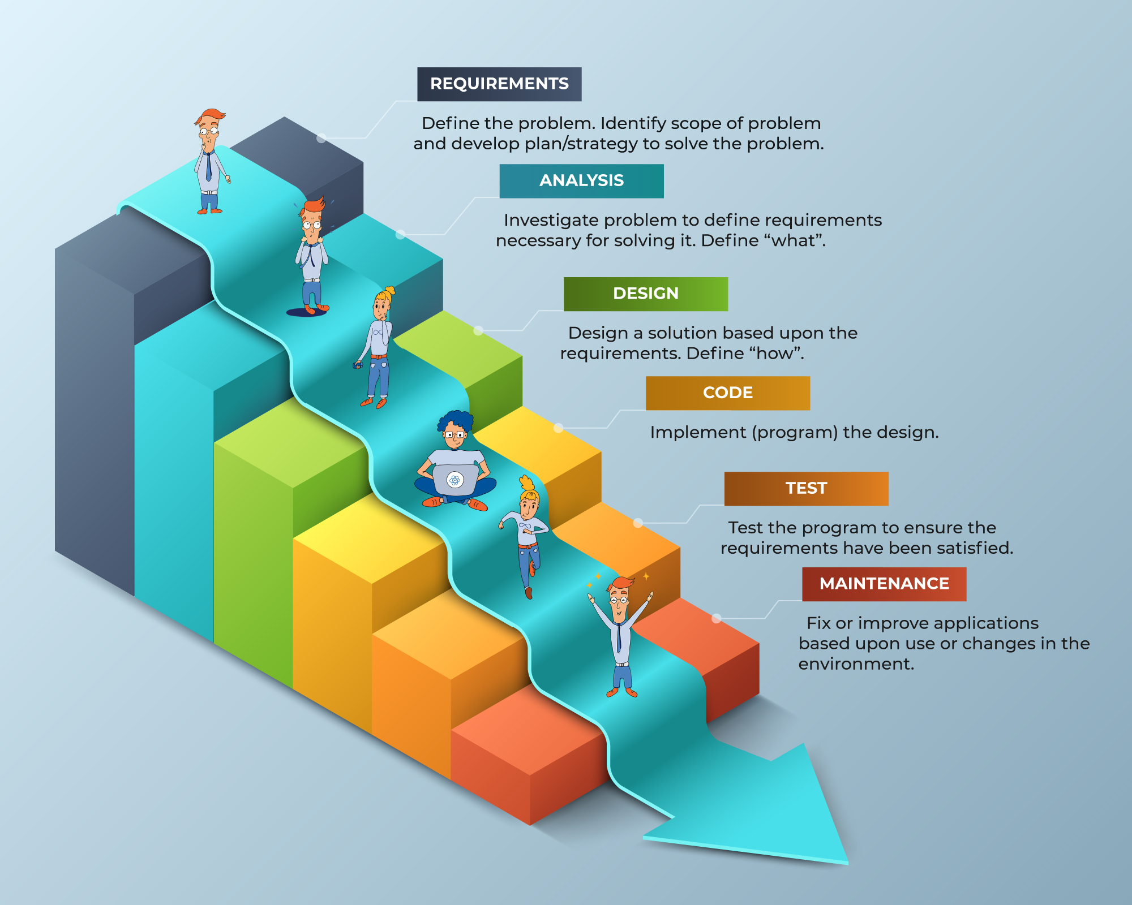
System Features and Functional Requirements
Development Model
In general, our team has decided to adopt the Waterfall Model for the development of this software. The reasons for this are as follows:
Well-defined and clear planning
Documentation
Linear development process
Detection of issues early on
Teamwork
Minimal involvement of the customer

Slide 14
Functional Requirements
The system must have a landing page which will display all the possible login or signup opportunities for all users: admin, patient, student, staff.
The system must only allow the patients to signup as staff members and dental students must be added by admin users, while students can also be added by staff users.
The system must allow the admin to possess all the functionalities that the other users can perform without exception.
The system must facilitate a different interface for each user, with a side panel that contains all the possible routes and alternatives and a dashboard which displays some data from the system and database.
The system must provide a constant connection to a database which will store all the different types of information.
The system should always display the names of the referenced foreign keys to have some meaning, although in the database they are simply stored as IDs.

Slide 15
Functional Requirements (Continued)
The system must always have as the first column of relational database table the primary key of that table, through which this table can be referenced in other relations.
The system should display at the end of the side bar a logout icon which will allow each user to go back to the landing page, giving them the opportunity to log back in again even as another user.
The system should allow the login even through a username and even through a email, leaving it to the preference of the user.
The system should display in the dashboard of each user the total number of entries for the selected entities.
The system should allow the admin users to create, read, update and delete staff members, students, patients, services, departments, appointments, x-rays, notes or emergency contacts.
The system should allow the staff to view, add, edit or delete students, patients, appointments, x-rays, notes or emergency contacts.
The system should allow the student to view patient and emergency contact details, as well as notes and x-rays but not edit them.

Slide 16
Nonfunctional and Other Requirements
Nonfunctional Requirements
The system should be secure and protect patient data privacy.
The system should be reliable and available 24/7.
The system should be responsive and fast, with minimal loading times.
The system should be easy to use, with a simple and intuitive user interface.
The system should be compatible with different operating systems and devices.
The system should comply with the regulations and standards of the healthcare industry.
The system should allow for the scheduling of multiple appointments over some time.
Domain Requirements

Slide 17
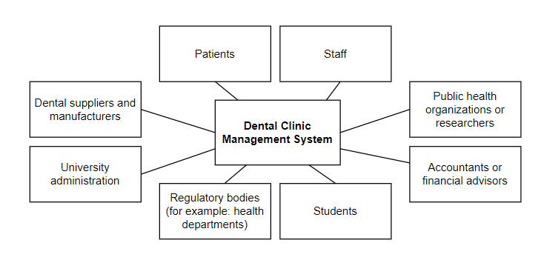
System Design and Modeling
Context Model
A context diagram is a high-level view of a system. It’s a basic sketch meant to define an entity based on its scope, boundaries, and relation to external components like stakeholders.

Slide 18
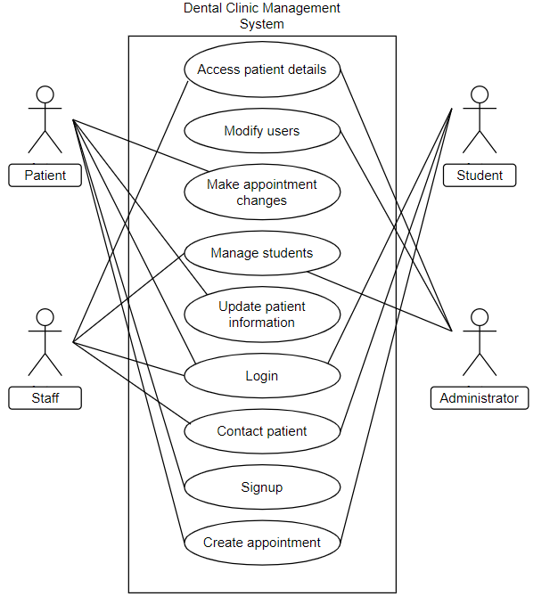
System Design and Modeling
Use Case Diagram
The use case diagram represents the various actions that can be performed by different actors in the dental clinic management system. The actors include the patient, the staff, the student, and the administrator.

Slide 19
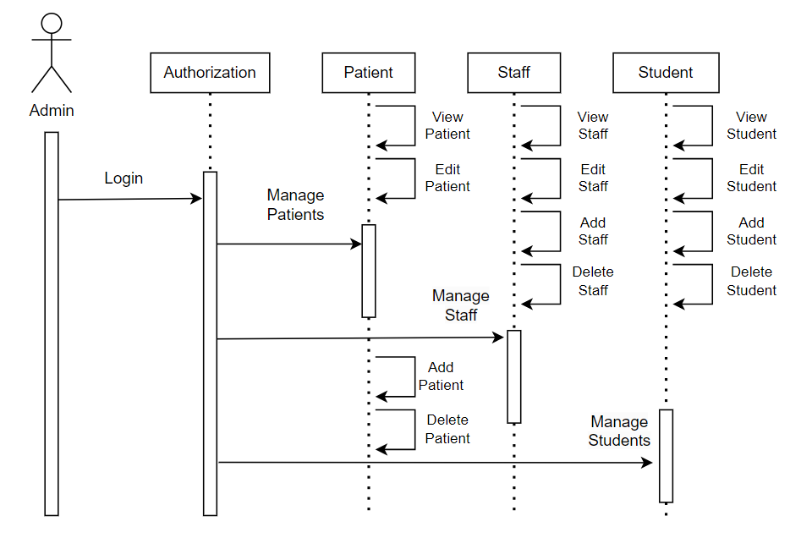
System Design and Modeling
Sequence Model
When we use sequence diagrams, we depict the interaction between objects in the order in which these interactions take place, therefore sequentially. We use these diagrams to explain and describe in what order and how the objects in a system function.

Slide 20

After a software system has been delivered to the client, it can still be modified and updated. This process is known as software maintenance.
Software Maintenance and Evolution
Maintenance
Bug corrections, new feature additions, performance enhancements, and software updates that make it compatible with new hardware and software platforms can all fall under this category.
By making suggestions for enhancements and resolving current problems, it keeps the product current failure-free and continuously monitors the performance operations. The system's features and ease of use are enhanced by an upgrade.

Slide 21


Software Maintenance and Evolution
Factors to Consider for Evolution
New Requirements
Business environment change
Errors
Performance, reliability need improvement
Potential Changes to Our Application
Adding a feedback or rating session.
Credit card payment through website.
Instant messaging between patient and dentist.
Private patient historical data session accessed only by the patient and relevant dentist.
Patient reminders for upcoming appointments.

Slide 22
Software Testing
Software testing is essential for making sure the dental clinic management system software is of high quality, trustworthy, and functional. Various testing procedures and techniques are used throughout the development process to find and fix potential flaws, faults, and vulnerabilities.
Testing in our case has been done incrementally, each time a new piece of code was implemented. Team members ensured that whenever a new functionality was added to the system many test cases with sample data and scenarios were done to make sure everything was working properly.

Slide 23
Division of Work
Ania Keci completed the code for the dental clinic management system and contributed with the initial idea of the system and technical side.
Belita Hysaj organized the functional and nonfunctional requirements as well as the purpose, document convention of the introduction.
Idi Xhengo prepared and structured the Software Maintenance & Evolution as well as the external interface requirements.
Klea Lala prepared the System Design and Modeling while also assisting with the overall description.
Renis Garxenaj constantly assisted with software testing, prepared the product scope as well as the intended audience and reading suggestions.

Slide 24
Thank you!

